Slide 1
3 phase MFDC SPOT WELDING MACHINE

Slide 2
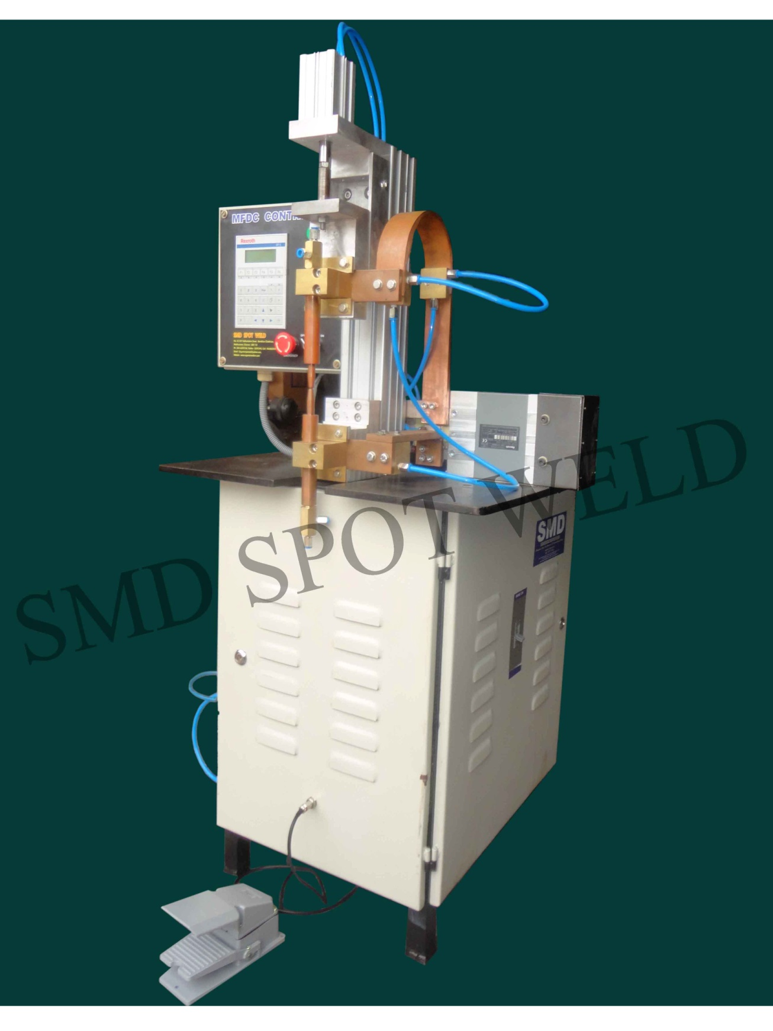

Slide 3
3phase MFDC SPOT WELDING MACHINE
ADVANTAGES:
Advantages of Bosch MFDC Control
• Bosch MFDC Controls can be upgraded to Adaptive controls with add-on card
• Integrated Timer Compact in size - Space saving
• Weld quality improvement by dynamic current control
• Weld-ability of different materials by powerful energy supply
• Increased electrode life due to lower thermal & mechanical load
• Reduced spatters due to decreased weld current & weld time
• Selectable I/O Interface discrete, Profibus, Interbus, Devicenet
• Suitable for Robotic, Manual and Machine Applications
• Single software BOS 6000 for AC,MFDC and Adaptive Control
• Programming can be done by Software BOS6000 as well with BT6 Display unit
• Central programming by Field bus module Ethernet (Optional at extra cost)
• Up to 2,50,000 Protocols can be stored in the database
• Current Profile, Pressure Profile
• Current Monitoring, Time Monitoring
• Current Stepper, Tip Dress Management
• Wear Counter, Parts
• Spot Selection, Diagnostics
• Data Logging, Backup / Auto Backup
• Offline Programming

Slide 4
• Current and Pressure Scaling
• Tolerance Band, Current Log
• Spot Repetition, Spot Table
• Protocols, weld current & fault, error, data
• Built in current sensor, No need for external sensors
• Suitable for single and dual gun applications
• 256 Programs for Robotic and stationary applications
• Available in both air cooled and water cooled versions
• Overvoltage protection: MOV
• Temperature supervision: Integrated
• Nominal Voltage: 400 V-20 % … 480 V +10%, //50/60 Hz//
• Provision to use Proportional valve
• Inverters with integrated servo gun control
• UL Certification
• Fifty years of Resistance welding Experience
• Provider of weld control and weld process know-how to the car industry
• Market leaders in Europe
More Features of Adaptive control
• Variation of welding parameters during the welding process to ensure weld
size
• Disturbances are compensated automatically
• Online documentation of measured curves

